Slide 1
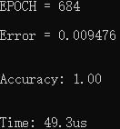
C timing

Slide 2
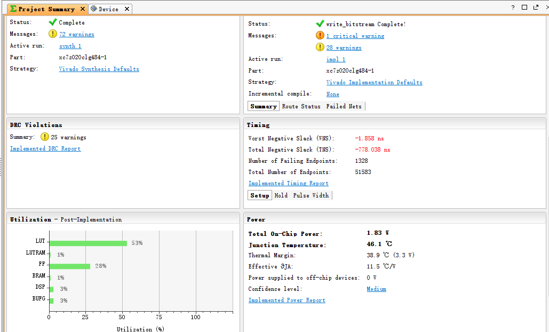
60 MHz Series

Slide 3
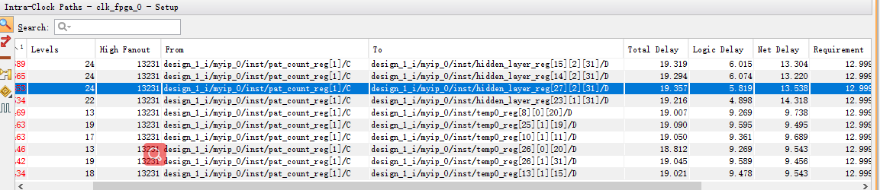
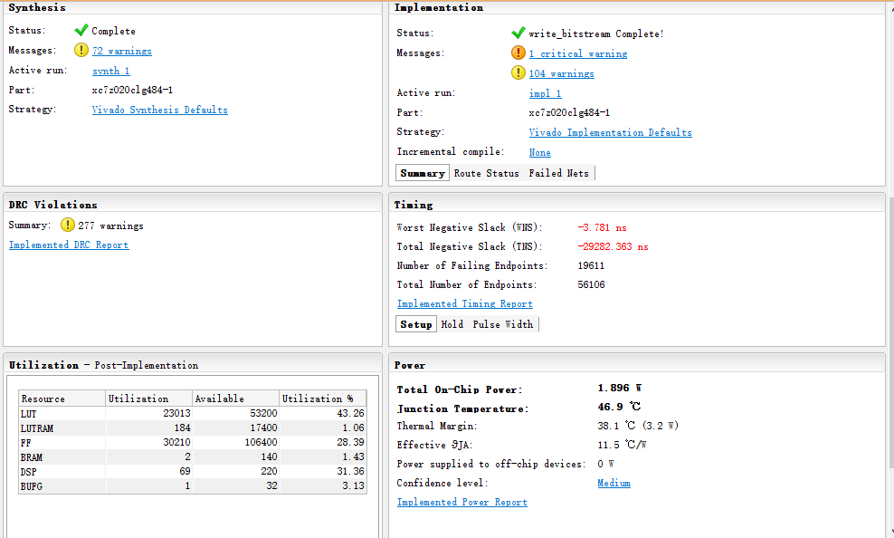
80MHz parallel

Slide 4
Timing
Parallel
Input layer to hidden layer
1149 clock cycle
Hidden layer to output layer
85 clock cycle
Series
Input layer to hidden layer
4509 clock cycle
Hidden layer to output layer
337 clock cycle
Parallel
Frequency | 55MHz | 80MHz
In to Hid | 20.9us | 14.3us
Hid to Out | 1.5us | 1.0us
Total | 22.4us | 15.3us
Series
Frequency | 60MHz
In to Hid | 75.2us
Hid to Out | 5.6us
Total | 80.8us

Slide 5
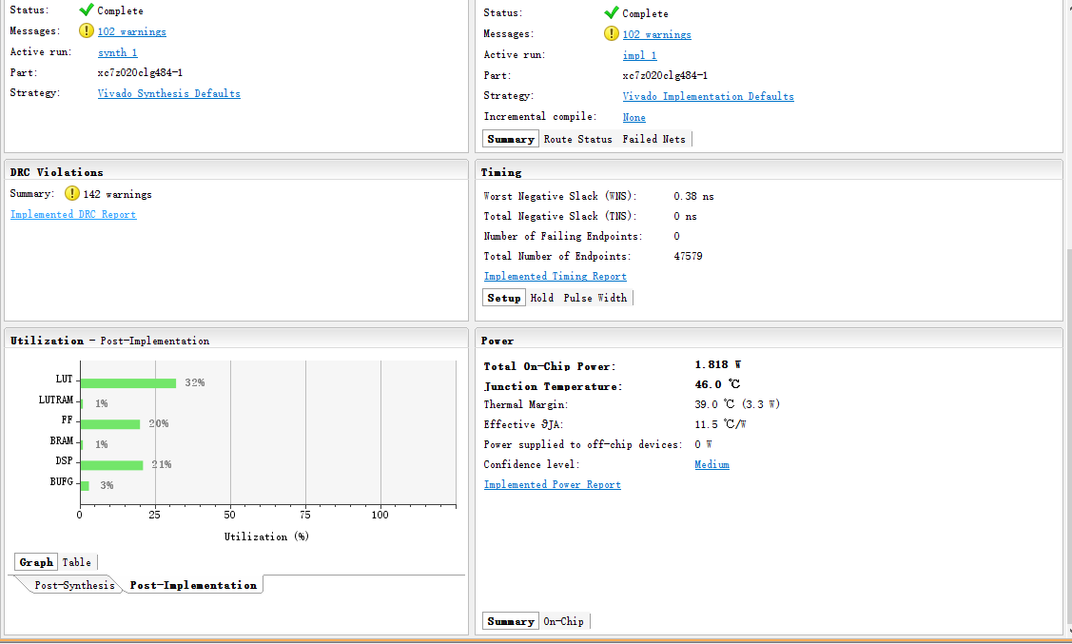
55MHz parallel

Slide 6
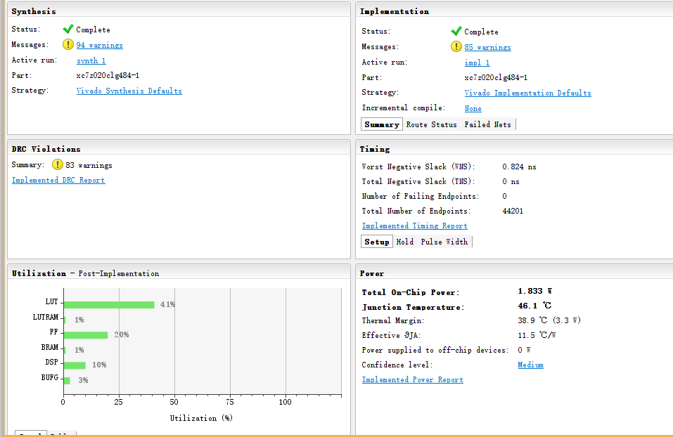
60MHz parallel

